Slide 1
Makahiki-SNA First steps
Philip Johnson
Collaborative Software Development Laboratory
Information and Computer Sciences
University of Hawaii

Slide 2
Basic idea
Visualize Kukui Cup activity (or lack thereof) among the 1000 residents in the 40 floors of the four Hale Aloha towers.
We want to represent:
Whether a resident has played at all.
Relative level of engagement of resident
engagement == number logged events
Engagement of floor
engagement == number points
Is resident active in system during a given timestep.

Slide 3
Timesteps
The 20 days of the challenge during September are represented by 80 timesteps.
Each timestep represents 6 hours of real time. 4 timesteps per day.
Each timestep lasts 1 second.
Total time of visualization: 80 seconds.

Slide 4
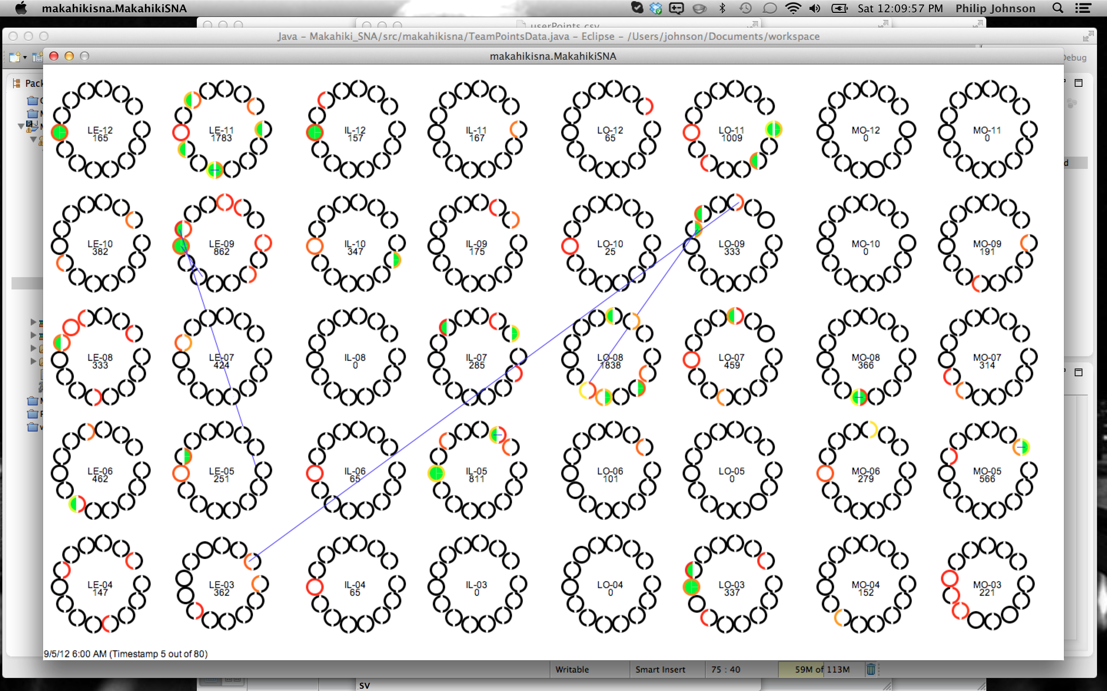
Four Towers: LE, IL, LO, MO

Slide 5
Five lounges: A, B, C, D, E

Slide 6
Lehua-E

Slide 7
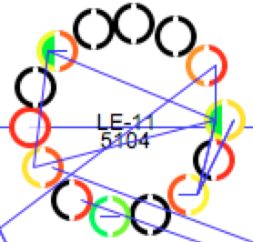
Representation of a floor
Each circle represents a room on a floor.
Rooms can be singles or doubles; there is one single per floor.
Color of circle (or circle half) represents engagement of player:
Black: no login
Red->Orng->Yell->Gre->Blue
Interior of circle is green if player is active during this timestep, white otherwise.
Floor label includes number of points accumulated by this floor at the time of the timestep.
Blue lines indicate current/prior "social activity" (referral or social bonus)

Slide 8
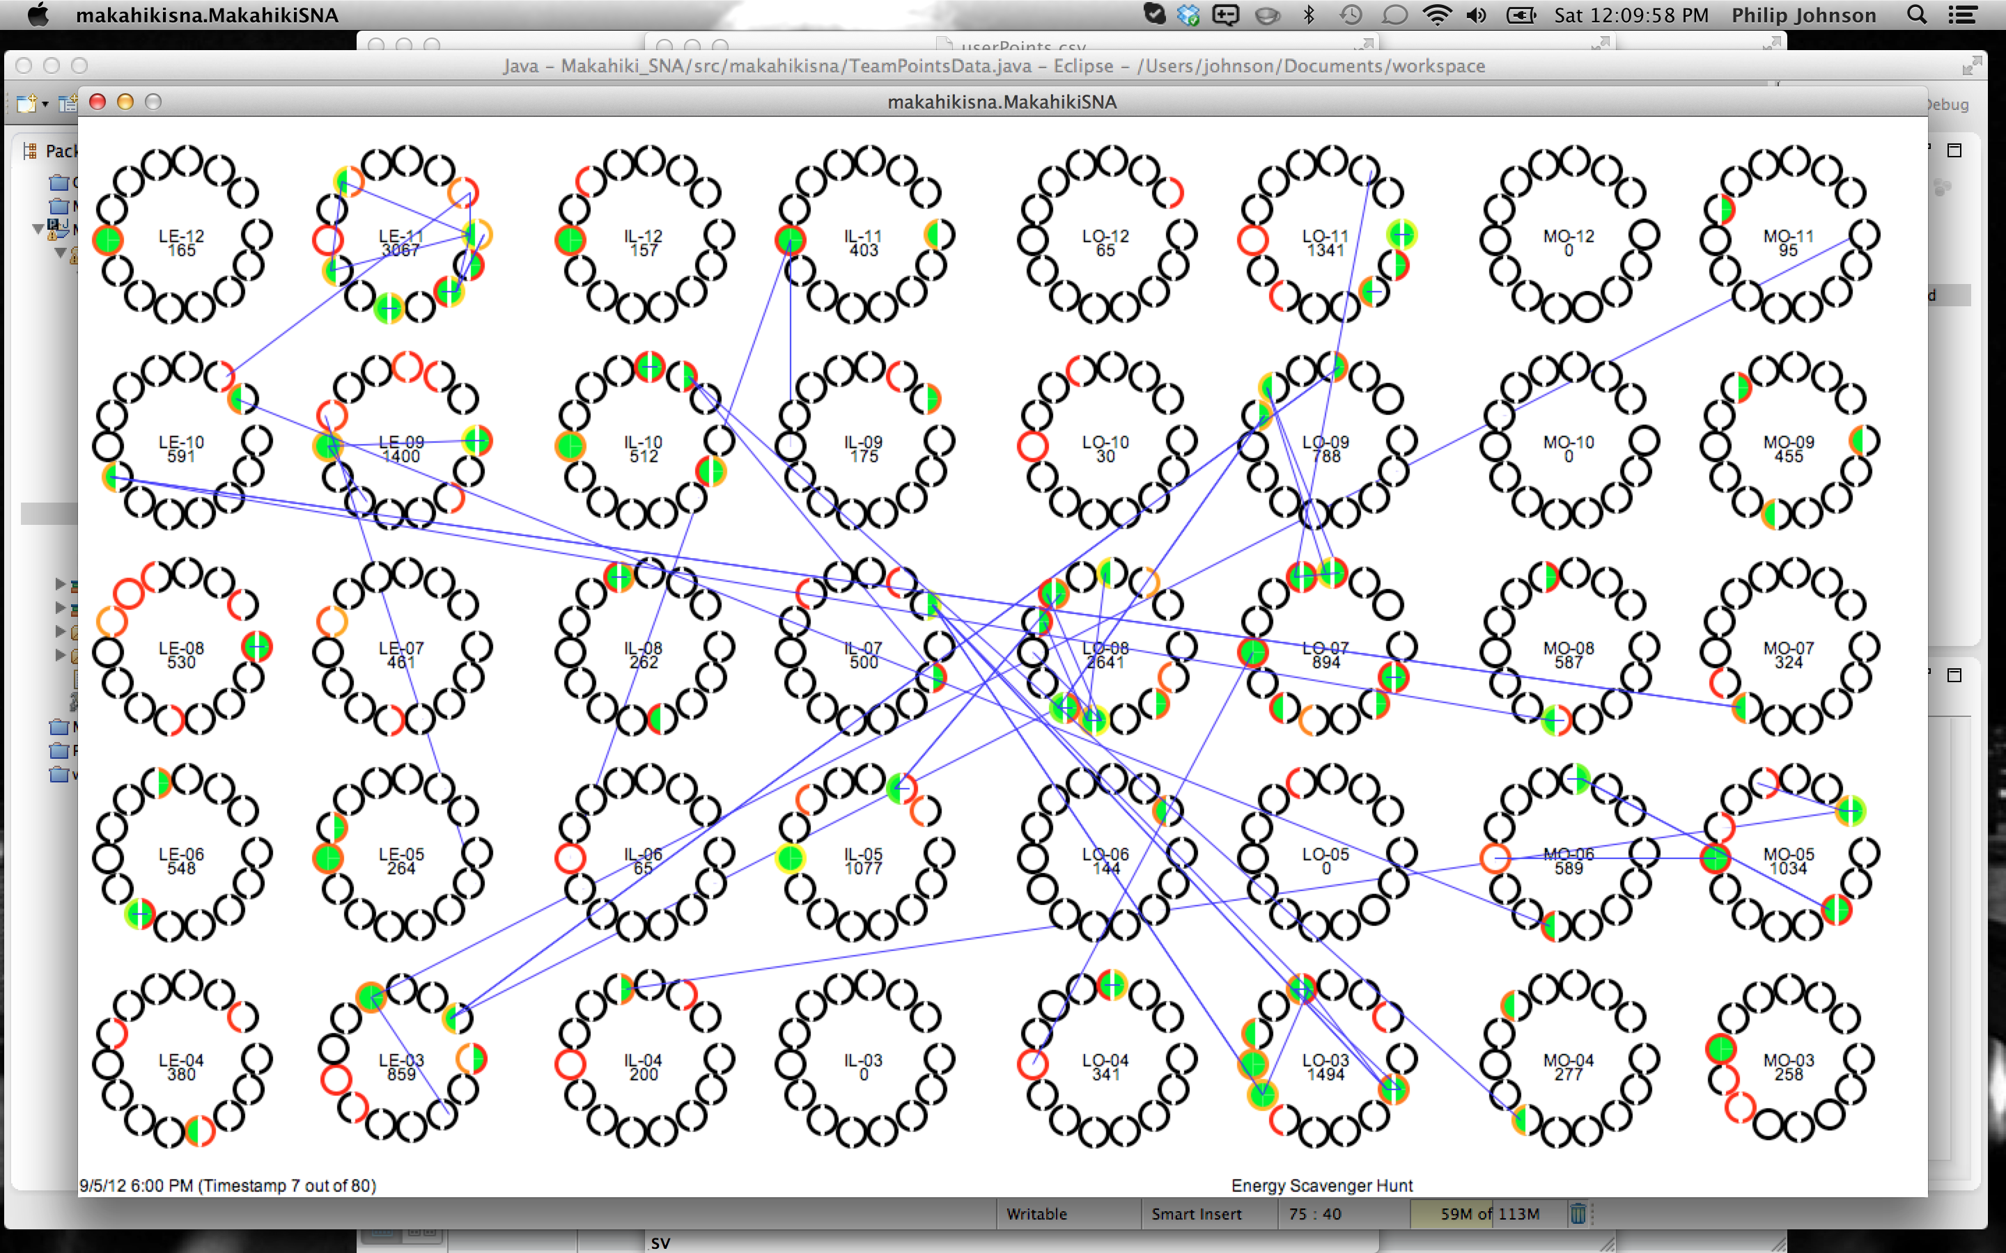
Status line
Left side:
Current time in simulations.
Which timestamp.
Right side:
When there was an event during the time period corresponding to the timestep, it is displayed.

Slide 9
How to study this visualization
Go to full screen mode in youtube.
Use pause and rewind.
Are there identifiable patterns?
Are there hypotheses?
Take notes: for a given timestep, what do you see of interest?

